Slide 1

Outlines
Sequential Logic
  Sequential Cicruits
  Types of Sequential Cicuits
    Synchronous
    Asynchronous
  Synchronous Sequential Circuits
  Storage Elements : Latches

Slide 2
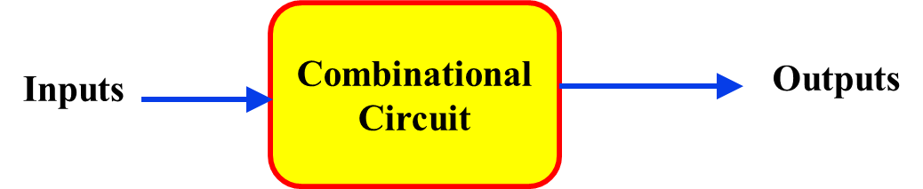
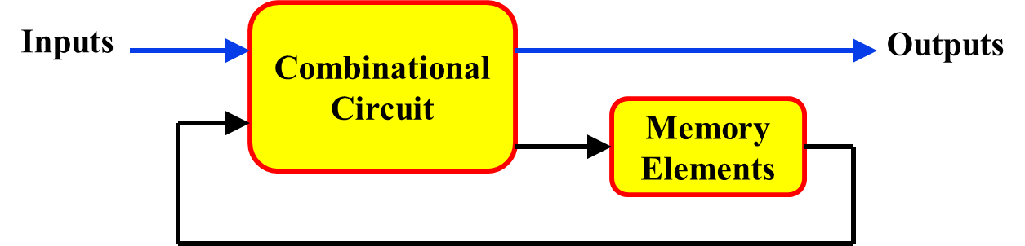
Types of Logic Circuits
Combinational
Sequential
Combination of I/ps + Present states of storage elements
O/p depends on
Combination of I/ps
Elements involved
Logic gates
Logic gates + Storage elements
Feedback present?
No
Yes

Slide 3
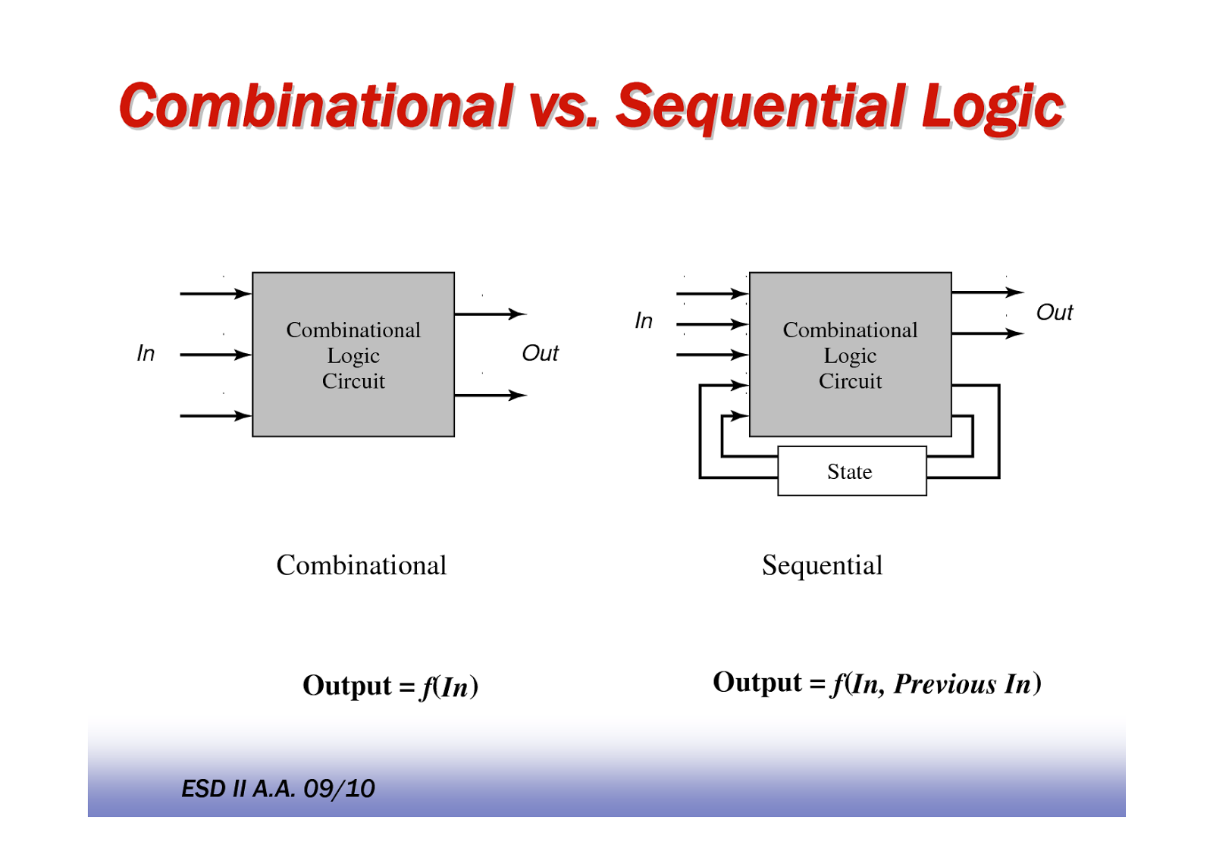
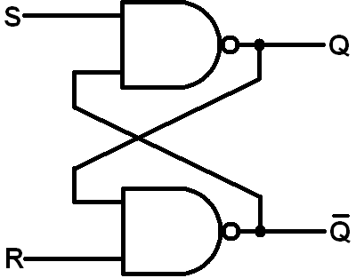
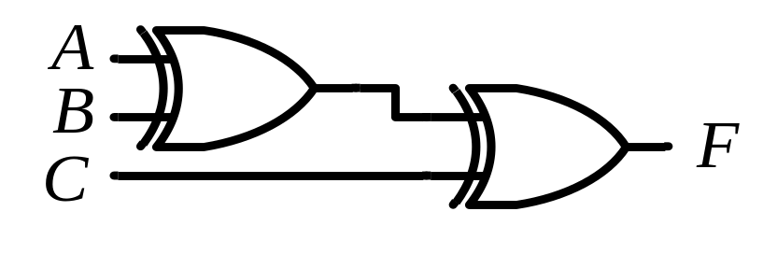
Types of Logic Circuits
Combinational
Sequential
Example
NOT for understanding

Slide 4
Sequential Circuits (Terminology)
Storage elements:
  Devices capable of storing binary information
    Latches
    Flip Flops
State:
  Binary info. stored in the elements at any given time defines state of the sequential circuit at that time
Output:
  The sequential circuit receives binary information from external inputs that together with the present state of the storage elements, determine the binary value of the outputs

Slide 5

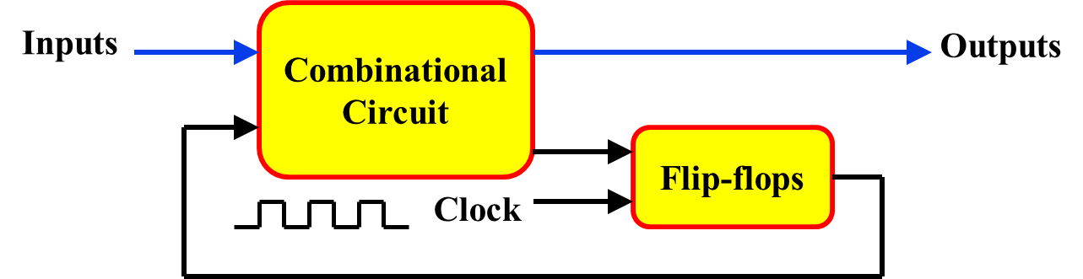
Types of Sequential Circuits
Synchronous
Asynchronous
Changes in state of memory elements
are synchronized by a clock signal
occur in direct response to signal changes on I/p lines
Cct. driven by
Clock
Input events drive the cct.
Time-delay devices
Storage elements
Flip Flops
Design
Easy
Difficult

Slide 6
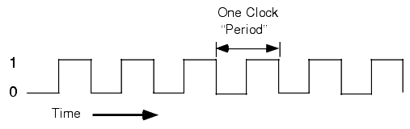
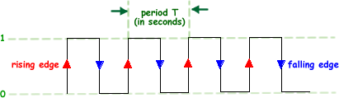
Clock
Periodic train of clock pulses
A clock is a special signal whose O/p continuously alternates between 0 and 1
The time it takes the clock to change from 1 to 0 and back to 1 is called the clock period (or clock cycle time)

Slide 7
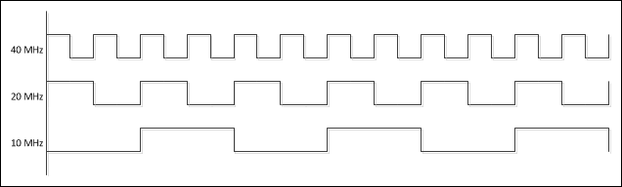
Clock Frequency
The clock frequency is the inverse of the clock period
The unit of measurement for frequency is the hertz (Hz)
How the waveforms of CLK with freq. (given below) look like:
  10 MHz
  20 MHz
  40 MHz

Slide 8
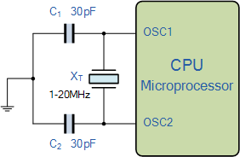
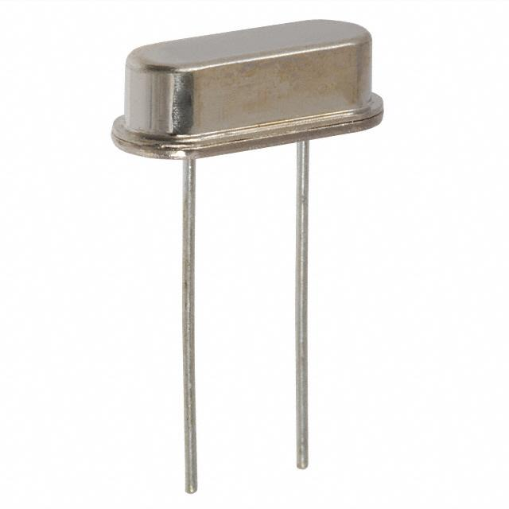
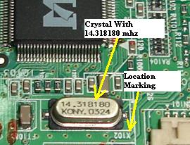
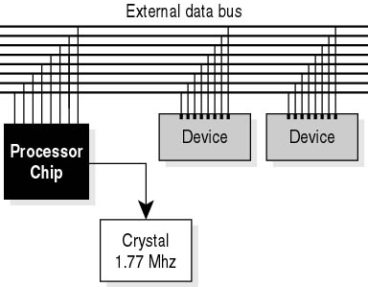
How Clock is Generated?

Slide 9
Role of Clock in Synch. Cct.
Clocks are often used to synchronize circuits
  If several circuits share a common clock signal, they can coordinate their actions w.r.t. one another
This is similar to how humans use real clocks for synchronization
All processors run with an internal clock

Slide 10
Role of Clock in Synch. Cct.
CLK affects the storage element at only discrete instants of time
In practice:
  CLK pulses determine when an activity will occur within the cct.
  External I/ps determine what changes will take place affecting the storage elements and O/ps
A cct. for adding and storing two binary numbers would:
  Compute their sum from the values of the numbers
  Store the sum at the occurrence of a CLK pulse
Example
Ans. must be available prior to occurrence of CLK pulse
Speed of Combinational cct.

Slide 11
What Exactly is Memory?
A memory should have at least three properties:
  It should be able to hold a value
  You should be able to read the value that was saved
  You should be able to change the value that’s saved
We’ll start with the simplest case, a one-bit memory:
  It should be able to hold a single bit, 0 or 1
  You should be able to read the bit that was saved
  You should be able to change the value. Since there’s only a single bit, there are only two choices:
    ̶ Set the bit to 1
    ̶ Reset, or clear, the bit to 0

Slide 12
Storage Elements(Memory)
Latches
Flip Flops

Slide 13
Latches
Latches are level sensitive storage elements.
They operate based on whether signals are at logic levels0 or 1, not on logic transitions from 0 -> 1 or 1 -> 0.
Latches are not really too useful for synchronous sequential circuits (they are for asynchronous circuits), but form the basis from which flip-flops are built.

Slide 14
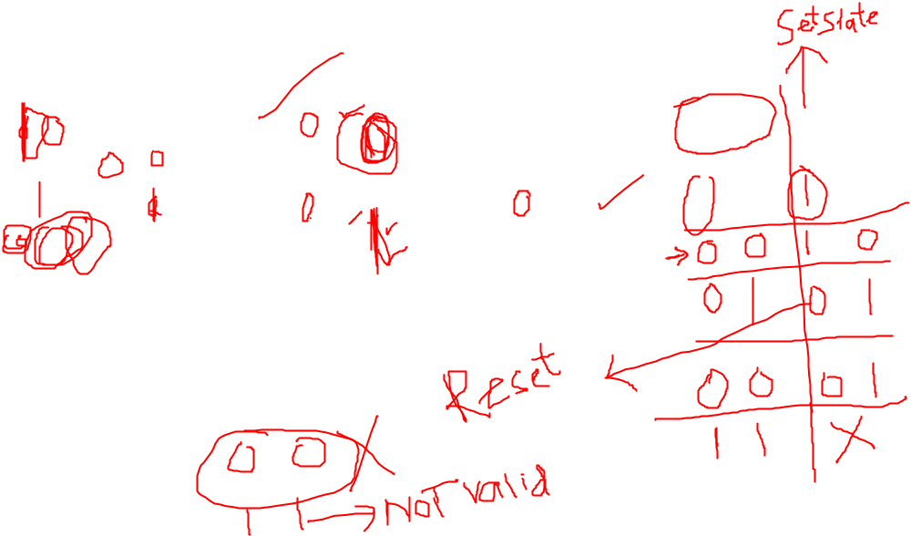
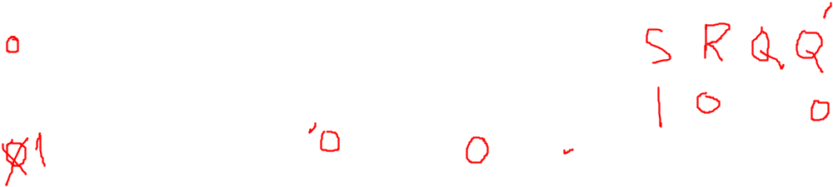
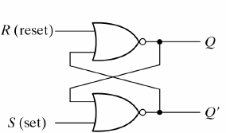
SR Latch (NOR implementation)
Consider the operation of the following circuit:
NOR Gate
Input |  | Output
A | B | F
0 | 0 | 1
0 | 1 | 0
1 | 0 | 0
1 | 1 | 0
Q_{next} = (R + Q’_{current})’
Q’_{next} = (S + Q_{current})’

Slide 15

SR Latch (NOR implementation)
In general (one exception, see below), the outputs are complements of each other (this is why they are labeled Q and Q’
a) When S=1, R=0
the output is Q=1, Q’= 0and the circuit in the set state.
b) When S=0, R=1
the output is Q=0, Q’=1and the circuit in the reset state.
c) When S=0, R=0
the output holds at its previous value (storage).
d) When S=1, R=1
the output is Q=Q’=0which is not desirable.We want to avoid this combination of inputs.

Slide 16
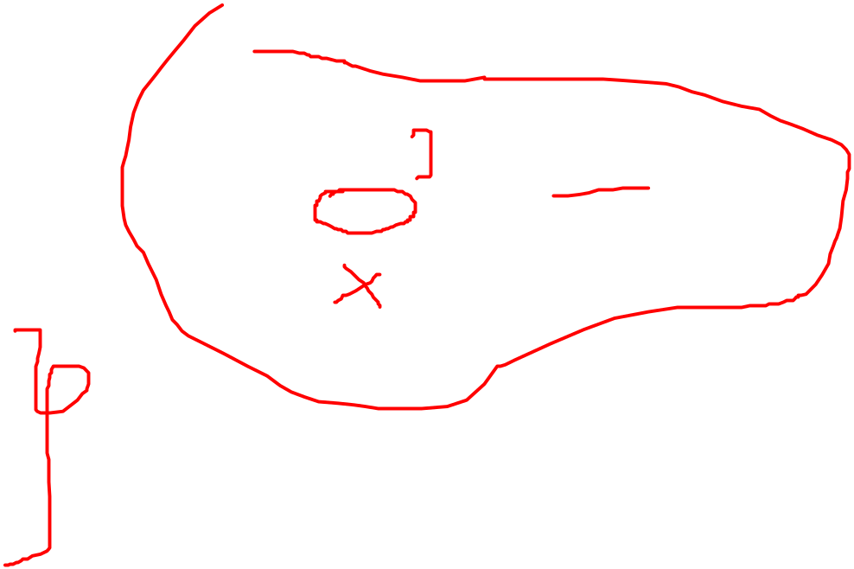
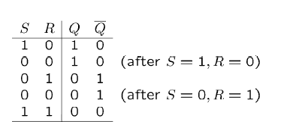

SR Latch (NOR implementation)
Q_{next} = (R + Q’_{current})’
Q’_{next} = (S + Q_{current})’

Slide 17
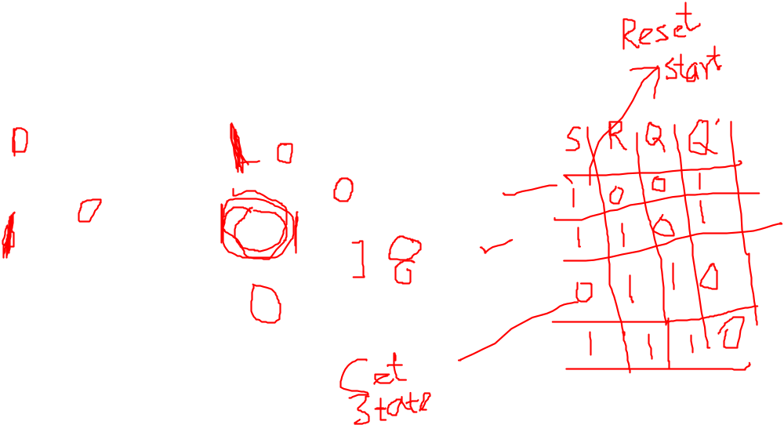

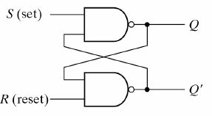
SR Latch (NAND implementation)
NAND Gate
Input |  | Output
A | B | F
0 | 0 | 1
0 | 1 | 1
1 | 0 | 1
1 | 1 | 0
Q_{next} = (S . Q’_{current})’
Q’_{next} = (R.Q_{current})’

Slide 18
SR Latch (NAND implementation)
In general (one exception, see below), the outputs are complements of each other (this is why they are labeled Q and Q’.
a) When S=0, R=1
the output is Q=1, Q’=0and the circuit in the set state.
b) When S=1, R=0
the output is Q=0, Q’=1and the circuit in the reset state.
c) When S=1, R=1
the output holds at its previous value (storage).
d) When S=0, R=0
the output is Q= Q’=1which is not desirable.
So, it works similar to the NOR implementation, but the input values are reversed for each of the different cases.

Slide 19
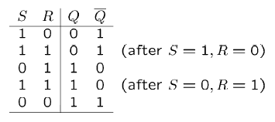

SR Latch (NAND implementation)
Q_{next} = (S . Q’_{current})’
Q’_{next} = (R.Q_{current})’

Slide 20

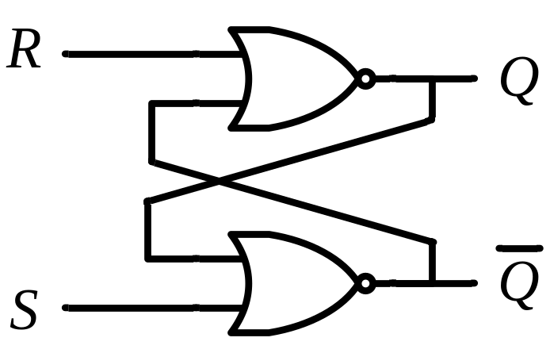
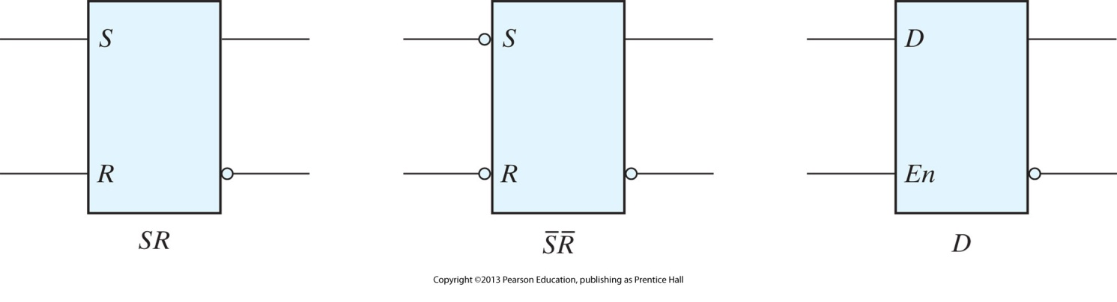
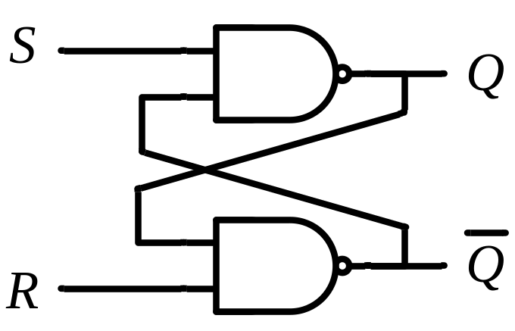
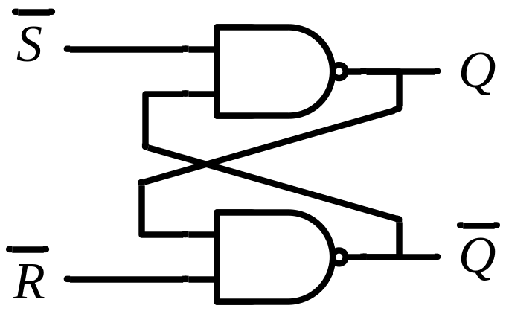
Latch Graphical Representations
S R | Q
0 0 | Q_{current}
0 1 | 0
1 0 | 1
1 1 | Q=Q’=0
No change
Reset
Set
Invalid
S R | Q
0 0 | Q=Q’=1
0 1 | 1
1 0 | 0
1 1 | Q_{current}
Invalid
Set
Reset
No change
Setting and resetting occur with a logic-0 signal

Slide 21

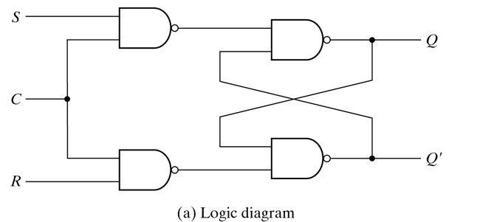
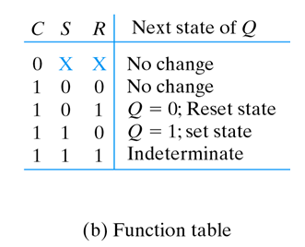
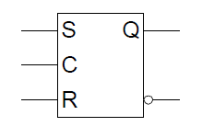
S-R Latch with control input

Slide 22
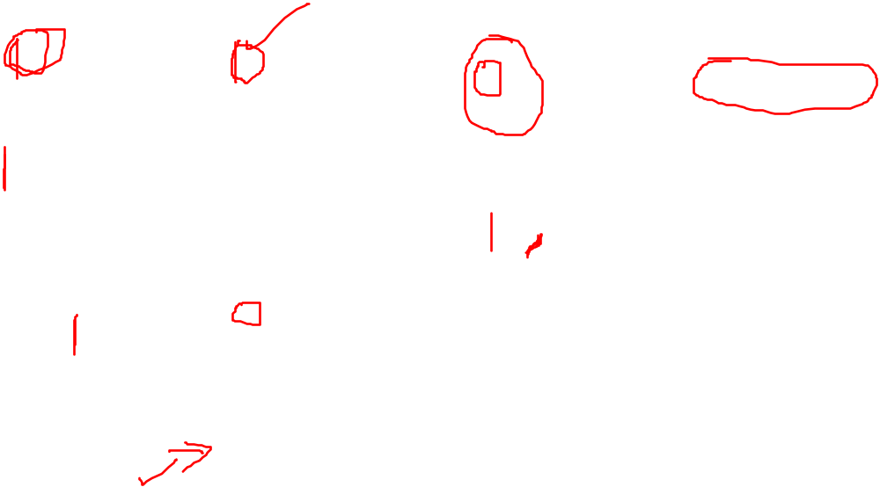
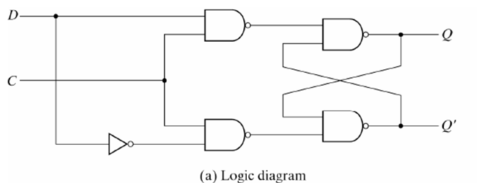
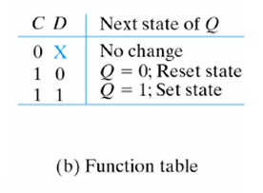
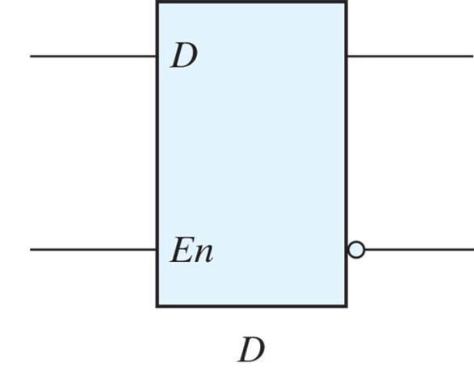
D-Latch

Slide 23
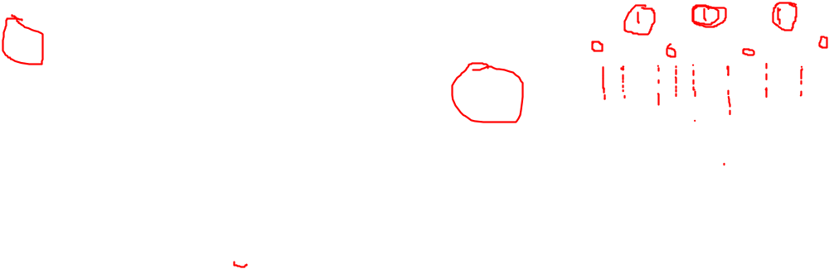
D Latch (D – Data)
Timing Diagram
C
D
C D | Q
0 x | Q₀
1 0 | 0
1 1 | 1
Q
No change
Reset
Set
t
Output may change
Sensitive to levels
Level triggered
C

Slide 24
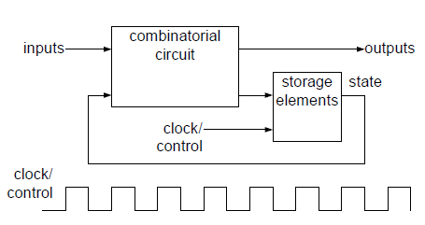
Problem With Latch

Slide 25

Master-Slave D Flip Flop
Consider two latches combined together
Only one C value active at a time
D Latch
(Master)
D Latch
(Slave)
D
D
C
Q
D
C
Q
Q
CLK

Slide 26
D Flip-Flop
  When the output of F/F will change? When CLK will be??
D Latch
(Master)
D Latch
(Slave)
D
D
C
Q
D
C
Q
Q
CLK
Master
Slave
Looks like it is negative edge-triggered
CLK
D
  i.e. a change in the output of the flip-flop can be triggered only by and during the transition of the clock from 1 to 0
Q_{Master}
Q_{Slave}
Notes:
Note the layout here.
The flip-flop input D is connected directly to the master latch.
The master latch output goes to the slave.
The flip-flop outputs come directly from the slave latch.

Slide 27
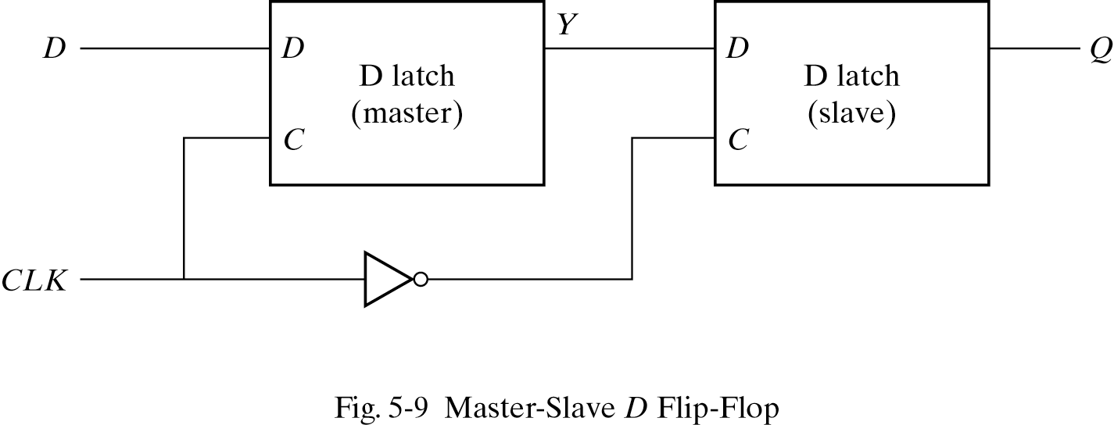

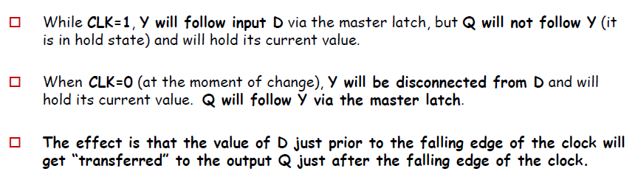
Master-Slave D Flip Flop

Slide 28
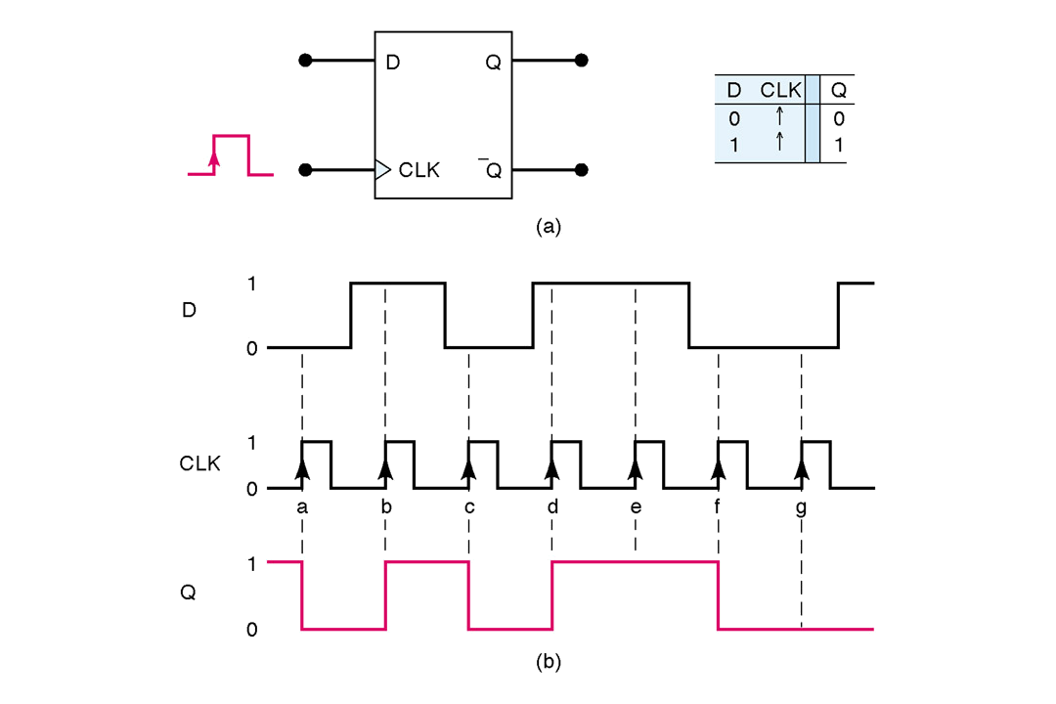
Timing Diagram of D Flip-Flop
Stores a value on the positive edge of C
Input changes at other times have no effect on output

Slide 29
Graphical Representations of DFF
D
Q
D
Q
Q
Q
Negative Edge
Positive Edge

Slide 30
Characteristic Table and Equation of D Flip Flop
Positive edge triggered
D C Q(t+1) Q’(t+1)
D
Q
0 0 1
1 1 0
Reset
Set
C
Q’
X 0
Q(t) Q’(t)
Characteristic Equation
Q(t+1)= D

Slide 31
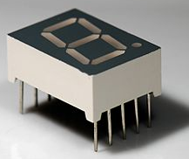
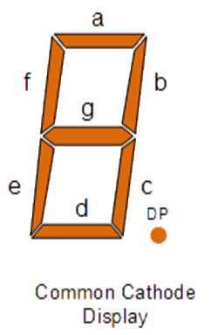
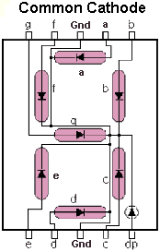
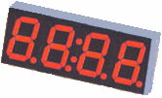
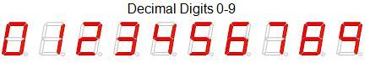
Design (BCD → 7 Segment Converter)
Example

Slide 32

Design (BCD → 7 Segment Converter)
Example
a
w x y z | a b c d e f g
0 0 0 0 | 1 1 1 1 1 1 0
0 0 0 1 | 0 1 1 0 0 0 0
0 0 1 0 | 1 1 0 1 1 0 1
0 0 1 1 | 1 1 1 1 0 0 1
0 1 0 0 | 0 1 1 0 0 1 1
0 1 0 1 | 1 0 1 1 0 1 1
0 1 1 0 | 1 0 1 1 1 1 1
0 1 1 1 | 1 1 1 0 0 0 0
1 0 0 0 | 1 1 1 1 1 1 1
1 0 0 1 | 1 1 1 1 0 1 1
1 0 1 0 | x x x x x x x
1 0 1 1 | x x x x x x x
1 1 0 0 | x x x x x x x
1 1 0 1 | x x x x x x x
1 1 1 0 | x x x x x x x
1 1 1 1 | x x x x x x x
w
x
y
z
a
b
c
d
e
f
g
f
b
?
g
e
c
BCD code
d
 |  |  |  | y
 |  | 1 |  | 1 | 1
 |  |  | 1 | 1 | 1 | x
w |  | x | x | x | x
 |  | 1 | 1 | x | x
 |  |  | z
a = w + y + xz + x’z’
b = . . .
c = . . .
d = . . .

Slide 33
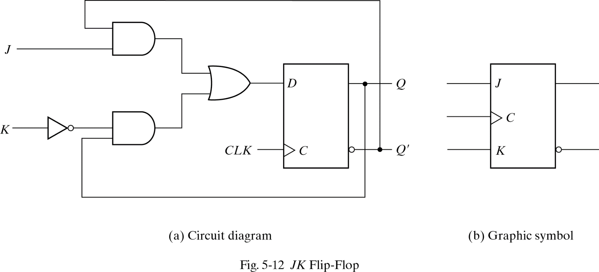
Positive Edge-Triggered J-K Flip-Flop
D=JQ’(t) + K’Q(t) = JQ’ + K’Q
Created from D flop
J sets
K resets
J=K=1 -> invert output
J
K
CLK
Q(t+1)
Q’(t+1)
0 0
Q(t) Q’ (t)
↑
0 1
0 1
↑
1 0
1 0
↑
1 1
↑
Toggle.

Slide 34
Characteristic Table and Equation of JK Flip Flop
Characteristic Equation:
D=JQ’(t) + K’Q(t) = JQ’ + K’Q
Q(t+1) = D
Q(t+1)= JQ’ + K’Q
Characteristic Table
J
K
CLK
Q(t+1)
Q’(t+1)
0 0
Q(t) Q’ (t)
↑
0 1
0 1
↑
1 0
1 0
↑
1 1
↑
Toggle.

Slide 35
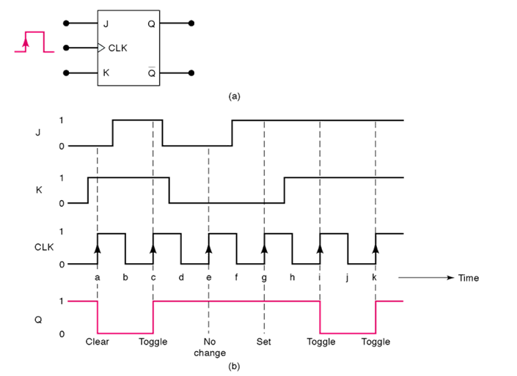
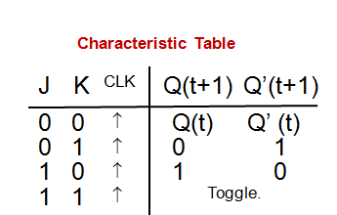
Timing Diagram of J-K Flip Flop
Two data inputs, J and K
J -> set, K -> reset, if J=K=1 then toggle output

Slide 36
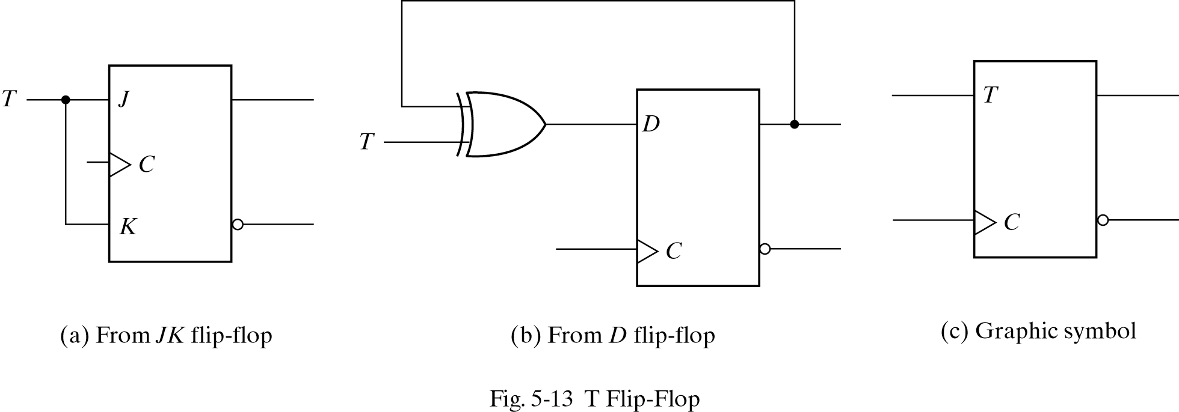
Positive Edge-Triggered T Flip-Flop
D=TQ’(t) + T’Q(t) = TQ’ + T’Q
Created from D flop
T=0 -> keep current
K resets
T=1 -> invert current
T
Q(t+1)
C
Q’(t+1)
0
Q(t) Q’(t)
↑
1
TOGGLE
↑

Slide 37
Characteristic Table and Equation of T Flip Flop
Characteristic Equation:
D=TQ’(t) + T’Q(t) = TQ’ + T’Q
Q(t+1) = D
Q(t+1) = TQ’ + T’Q
Characteristic Table
T
Q(t+1)
C
Q’(t+1)
0
Q(t) Q’(t)
↑
1
TOGGLE
↑

Slide 38
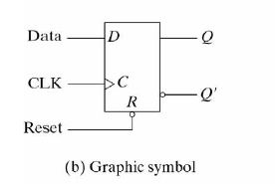
Asynchronous Inputs
Asynchronous inputs are used to force the flip flop to a particular state independently of the clock.
When the power is turned on in digital system, the state of flip flops is unknown. The asynchronous inputs are very useful to bring all flip flops in a known state before starting the clocked operation.
The input that sets the flip flop to 1 is called preset. And the input that sets the flip flop to ‘0’ is called reset.
R D
Q(t+1)
C
Q’(t+1)
0 X X 0 1
1 0 0 1
1 1 1 0

Slide 39
Analysis of Synchronous Sequential Circuits
Analysis:
  Describes what a given circuit will do under certain operating conditions
Behavior of the cct. is determined from:
  Inputs,
  Outputs
  State of its F/Fs.
O/p and next states are determined from:
  Inputs
  Present state of its F/Fs.

Slide 40
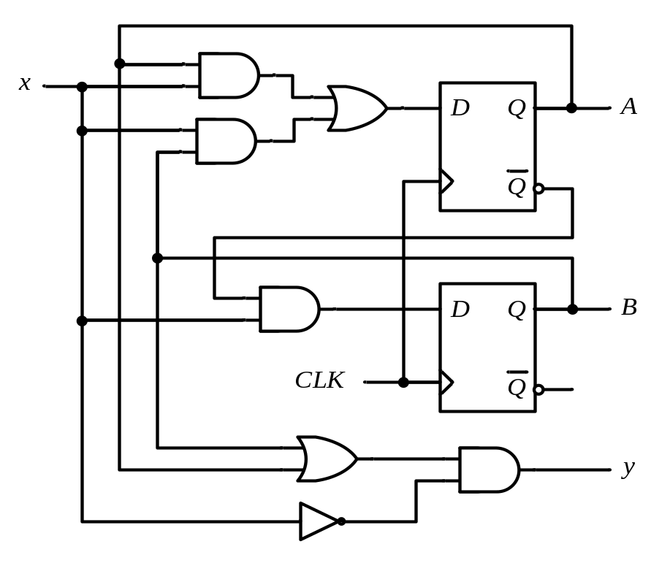
Analysis of Clocked Sequential Circuits
Analysis consists of obtaining:
  Boolean expressions (State Equations)
  Table (State Table)
  Diagram (State Diagram)
  for time sequence of inputs, outputs, and internal states
The State
  State = Values of all F/Fs
Example
A B = 0 0

Slide 41
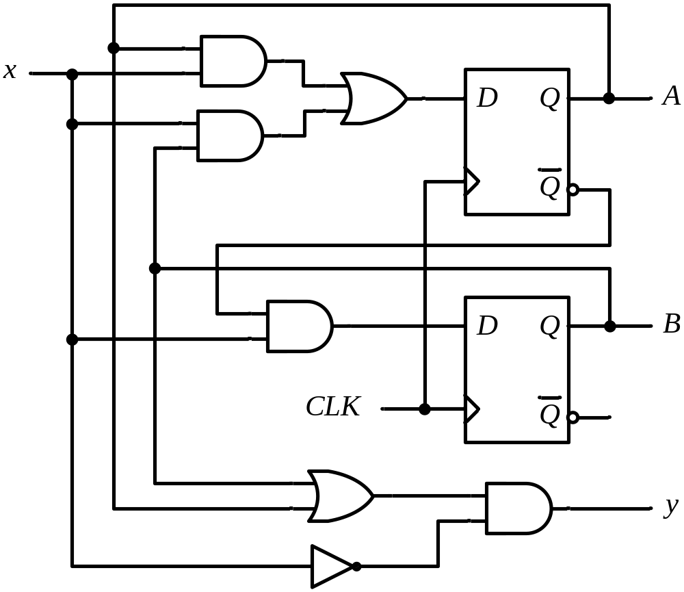
State Equations
Example
A(t+1) = D_{A}
= A(t) x(t)+B(t) x(t)
= A x + B x
B(t+1) = D_{B}
= A’(t) x(t)
= A’ x
y(t) = [A(t)+ B(t)] x’(t)
= (A + B) x’

Slide 42
State Table (Transition Table)
Example
Present State |  | Input | Next State |  | Output
A | B | x | A | B | y
0 | 0 | 0
0 | 0 | 1
0 | 1 | 0
0 | 1 | 1
1 | 0 | 0
1 | 0 | 1
1 | 1 | 0
1 | 1 | 1
0 0 0
0 1 0
0 0 1
1 1 0
0 0 1
1 0 0
0 0 1
1 0 0
A(t+1) = A x + B x
B(t+1) = A’ x
y(t) = (A + B) x’
t
t+1
t

Slide 43
State Table – Second Form
Example
Present State |  |  | Next State |  |  |  | Output
 |  |  | x = 0 |  | x = 1 |  | x = 0 | x = 1
A |  | B | A | B | A | B | y | y
0 |  | 0 | 0 | 0 | 0 | 1 | 0 | 0
0 |  | 1 | 0 | 0 | 1 | 1 | 1 | 0
1 |  | 0 | 0 | 0 | 1 | 0 | 1 | 0
1 |  | 1 | 0 | 0 | 1 | 0 | 1 | 0
t
t+1
t
A(t+1) = A x + B x
B(t+1) = A’ x
y(t) = (A + B) x’

Slide 44
State Diagram
Example
Present State |  |  | Next State |  |  |  | Output
 |  |  | x = 0 |  | x = 1 |  | x = 0 | x = 1
A |  | B | A | B | A | B | y | y
0 |  | 0 | 0 | 0 | 0 | 1 | 0 | 0
0 |  | 1 | 0 | 0 | 1 | 1 | 1 | 0
1 |  | 0 | 0 | 0 | 1 | 0 | 1 | 0
1 |  | 1 | 0 | 0 | 1 | 0 | 1 | 0
AB
input/output
0/0
1/0
0/1
0 0
1 0
0/1
1/0
0/1
1/0
0 1
1 1
1/0

Slide 45
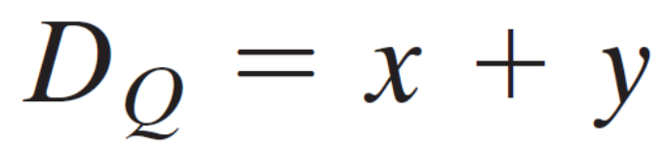
Summary
The state diagram gives a pictorial view of state transitions and is the form more suitable for human interpretation of the circuit’s operation .
Notation:
The I/p Eq. specifies an OR gate with inputs x and y connected to the D input of a flip-flop whose output is labeled with the symbol Q

Slide 46

Analysis of Clocked Seq. Ccts (JK-F/F)

Slide 47
Analysis of Clocked Seq. Ccts (JK-F/F)
Present State |  | I/P | Next State |  | Flip-Flop Inputs
A | B | x | A | B | J_{A} | K_{A} | J_{B} | K_{B}
0 | 0 | 0
0 | 0 | 1
0 | 1 | 0
0 | 1 | 1
1 | 0 | 0
1 | 0 | 1
1 | 1 | 0
1 | 1 | 1
0 1
0 0
1 1
1 0
1 1
1 0
0 0
1 1
0 0 1 0
0 0 0 1
1 1 1 0
1 0 0 1
0 0 1 1
0 0 0 0
1 1 1 1
1 0 0 0
J_{A} = B K_{A} = B x’
J_{B} = x’ K_{B} = A ⊕ x
A(t+1) = J_{A} A’ + K’_{A} A
= A’B + AB’ + Ax
B(t+1) = J_{B} B’ + K’_{B} B
= B’x’ + ABx + A’Bx’

Slide 48
Analysis of Clocked Seq. Ccts (JK-F/F)
Present State |  | I/P | Next State
A | B | x | A | B
0 | 0 | 0
0 | 0 | 1
0 | 1 | 0
0 | 1 | 1
1 | 0 | 0
1 | 0 | 1
1 | 1 | 0
1 | 1 | 1
0 1
0 0
1 1
1 0
1 1
1 0
0 0
1 1
1
0
1
0 0
1 1
0
0
0
0 1
1 0
1
1

Slide 49

Analysis of Clocked Seq. Ccts (T-F/F)

Slide 50
Analysis of Clocked Seq. Ccts (T-F/F)
Present State |  | I/P | Next State |  | F.F Inputs |  | O/P
A | B | x | A | B | T_{A} | T_{B} | y
0 | 0 | 0
0 | 0 | 1
0 | 1 | 0
0 | 1 | 1
1 | 0 | 0
1 | 0 | 1
1 | 1 | 0
1 | 1 | 1
0 0
0 1
0 1
1 0
1 0
1 1
1 1
0 0
0 0
0 1
0 0
1 1
0 0
0 1
0 0
1 1
0
0
0
0
0
0
1
1
T_{A} = B x T_{B} = x
y = A B
A(t+1) = T_{A} A’ + T’_{A} A
= AB’ + Ax’ + A’Bx
B(t+1) = T_{B} B’ + T’_{B} B
= x ⊕ B

Slide 51
Analysis of Clocked Seq. Ccts (T-F/F)
Present State |  | I/P | Next State |  | F.F Inputs |  | O/P
A | B | x | A | B | T_{A} | T_{B} | y
0 | 0 | 0
0 | 0 | 1
0 | 1 | 0
0 | 1 | 1
1 | 0 | 0
1 | 0 | 1
1 | 1 | 0
1 | 1 | 1
0 0
0 1
0 1
1 0
1 0
1 1
1 1
0 0
0 0
0 1
0 0
1 1
0 0
0 1
0 0
1 1
0
0
0
0
0
0
1
1
0/0
0/0
0 0
1/0
0 1
1/1
1/0
1 1
1 0
0/1
0/0
1/0

